Slide 1


More Pandas
Wake Forest
School of Business
_______
Day 4

Slide 2

Agenda
Day 3 Leftovers
Rank(), nLargest, and nSmallest()
Summarization
Aggregate Function
Group by and Aggregate
Dealing with Multi-Indexes
Visualization 101 w. matplotlib
Histogram
Box Plot
Bar Chart
Line Plot

Slide 3
Converting a List to a Data Frame
Lists are cool but DataFrames are cooler
Lists: a list is essentially a collection of elements, which could be integers, floats, strings, or even other lists.
Why Convert a List to a DataFrame?
Analysis – pandas makes it easy to filter, summarize and analyze data
Data Manipulation – pandas makes it easy to change, update, sort, join and structure data.
Deal w. Big Data – DataFrames allow us to deal with “big” data
How to Convert a List to a DataFrame, is easy with pd.DataFrame() function.
import pandas as pd
# Example list my_list = [10, 20, 30, 40, 50]
# Convert list to DataFrame
df = pd.DataFrame(my_list, columns=['Numbers']) # Display the DataFrame print(df)

Slide 4

Open: Day 3.6 list to Pandas
10 Minutes

Slide 5
Converting a Dictionary to a Data Frame
Easy
import pandas as pd
# Sample dictionary
data = {
'Name': ['John', 'Emma', 'Peter'],
'Age': [25, 28, 32],
'City': ['New York', 'London', 'Paris']
}
# Convert dictionary to DataFrame
df = pd.DataFrame(data)
# Print the DataFrame
print(df)
To convert a dictionary to a pandas DataFrame, we can use the pd.DataFrame function provided by the pandas library.
The keys of the dictionary will become the column names of the DataFrame, and the corresponding values will populate the columns.
Name Age City
0 John 25 New York
1 Emma 28 London
2 Peter 32 Paris

Slide 6
Open: Day 3 Dictionary to Data Frames
10 Minutes

Slide 7
Dealing w. Nulls
Finding nulls
The isnull() and isna()functions are used to detect missing or null values in a Pandas DataFrame.
It returns a boolean mask, where True indicates a missing value and False indicates a non-missing value.
Syntax: DataFrame.isnull() or DataFrame.isna()
# Creating a DataFrame
data = {'Column1': [1, 2, None, 4, 5],
'Column2': ['a', 'b', 'c', None, 'e']}
df = pd.DataFrame(data)
# Checking for missing values
null_mask = df.isnull()
print(null_mask)
Column1 Column2
0 False False
1 False False
2 True False
3 False True
4 False False

Slide 8
Dealing w. Nulls
Finding nulls ok that’s not helpful
The isnull() and isna()functions are used to detect missing or null values in a Pandas DataFrame.
It returns a boolean mask, where True indicates a missing value and False indicates a non-missing value.
Use sum() to get the count of nulls per column.
Use sum(axis=1) to get a count of nulls per row.
# nulls by column
df.isnull().sum()
Column1 1
Column2 1
# nulls by row
df.isnull().sum(axis=1)
0 0
1 0
2 1
3 1
4 0

Slide 9
Dealing w. Nulls
Filling nulls in
The fillna function in Pandas is used to fill missing or null values in a DataFrame or Series.
It allows you to replace missing values with a specified scalar value, a dictionary mapping columns to values, or by using various filling methods.
Syntax: DataFrame.fillna(value, method, axis, inplace)
The value parameter specifies the value to use for filling missing values.
The method parameter determines the filling method to use (e.g., forward fill, backward fill, interpolation, etc.).
The axis parameter indicates the axis along which the filling operation is performed (0 for rows, 1 for columns).
The inplace parameter specifies whether to modify the DataFrame in place or return a new DataFrame with filled values.

Slide 10
Dealing w. Nulls
Filling nulls in
# Creating a DataFrame
data = {'Column1': [1, None, 3, None, 5],
'Column2': ['a', 'b', None, 'd', 'e']}
df = pd.DataFrame(data)
# Filling missing values with scalar value
df_filled = df.fillna(0)
# Creating a DataFrame
data = {'Column1': [1, None, 3, None, 5],
'Column2': [4, 2, None, 6, None]}
df = pd.DataFrame(data)
# Filling missing values with mean
df_filled = df.fillna(df.mean(), inplace=True)
print(df_filled)

Slide 11
Open: Day 3.6 Nulls
10 Minutes

Slide 12
Dealing w. Dates
Convert string to date.
In Pandas, you can convert a string representation of a date to a proper date format using the to_datetime function.
This conversion allows you to perform date-based operations and analysis on your data.
Syntax: pd.to_datetime(arg, format=None, errors='raise')
The arg parameter represents the input data that needs to be converted.
The format parameter specifies the format of the input string if it is not a standard date format.
The errors parameter determines how errors during conversion are handled.
# Creating a DataFrame
data = {'Date': ['2022-01-01', '2022-02-01', '2022-03-01']}
df = pd.DataFrame(data)
# Converting string to date
df['Date'] = pd.to_datetime(df['Date'])
print(df)

Slide 13
Dealing w. Dates
Filtering dates
You can use the query method to filter dates in a DataFrame based on different criteria, such as date ranges or specific dates.
Key thing to know! The default date format is yyyy-mm-dd and pandas will convert automagically
# Creating a DataFrame with a 'Date' column
data = {'Date': ['2022-01-01', '2022-02-01', '2022-03-01', '2022-04-01']}
df = pd.DataFrame(data)
# Converting 'Date' column to datetime type
df['Date'] = pd.to_datetime(df['Date'])
# Filtering dates using the query method
filtered_df = df.query("'2022-02-01' <= Date <= '2022-03-31'")
print(filtered_df)

Slide 14
Iterating over rows.
Iterrows
In Pandas, you can iterate over rows of a DataFrame using various methods, such as iterrows(), itertuples(), or index-based iteration.
Iterating over rows allows you to access and process individual rows or perform row-wise calculations or transformations.
NOTE: iterating over rows in Pandas IS slower compared to using vectorized operations, which are more EFFICENT (FASTER!)
# Creating a DataFrame
data = {'Name': ['John', 'Alice', 'Bob'],'Age': [25, 30, 35]}
df = pd.DataFrame(data)
# Iterating over rows using iterrows()
for index, row in df.iterrows():
print(f"Row index: {index}")
print(f"Name: {row['Name']}, Age: {row['Age']}")
print("---")

Slide 15
Ranking What Team is #1
team | athlete_count | Rank
Fight Sports | 8 | 1
10th Planet | 7 | 2
Atos | 7 | 2
B Team | 7 | 2
New Wave | 7 | 2
Alliance | 6 | 3
Gracie Barra | 5 | 4
Checkmat | 3 | 5
Dream Art | 3 | 5
Essential JJ | 3 | 5
Ranking is an important skill in data analysis
allows us to assign a numerical rank based on criteria.
understand the relative positions of data points
Ranking is useful:
Identifying top performers, outliers, or specific order in a dataset.
Prioritizing activity
Analyzing competitiveness or percentile distribution.

Slide 16
The challenge is What Team is #1
In golf the person with the lowest score is #1 while in most sports it’s the person with the highest score.
Ranking Data in Python:
Pandas provides a convenient rank() function for ranking data in a DataFrame or Series.
Syntax: df.rank(
method='method’,
ascending=True/False, na_option='keep/drop')
method parameter specifies the tie-breaking method, such as 'average', 'min', 'max', or 'dense'.
ascending parameter determines whether the ranking should be in ascending or descending order.
na_option parameter specifies how to handle missing values.
Technique | Count | RANK
Armbar | 1002 | 1
Triangle | 467 | 2
Kimura | 331 | 3
RNC | 328 | 4
Americana | 301 | 5
Ankle lock | 185 | 6
Collar Choke | 162 | 7

Slide 17
Basic Example
Student | Score
John | 85
Emily | 92
David | 78
Emma | 92
Michael | 81
Sophia | 78
Given These Student Scores How can I Rank them?
#1 highest performing student
#1 lowest performing student
# Rank the students based on their scores
StudentScores['Rank'] = StudentScores['Score'].rank(ascending=False)
Student | Score | Rank
John | 85 | 3
Emily | 92 | 1.5
David | 78 | 5.5
Emma | 92 | 1.5
Michael | 81 | 4
Sophia | 78 | 5.5
Notice the goofy Rank

Slide 18
Basic Example, try again #1 highest score
Student | Score
John | 85
Emily | 92
David | 78
Emma | 92
Michael | 81
Sophia | 78
Given Student Scores How can I Rank them?
# Rank the students based on their scores
StudentScores['Rank'] = StudentScores['Score'].rank(method = “min”, ascending=False)
Student | Score | Rank
John | 85 | 3
Emily | 92 | 1
David | 78 | 5
Emma | 92 | 1
Michael | 81 | 4
Sophia | 78 | 5
Notice now we get the right Rank

Slide 19
Basic Example, Suppose I want to rank by worst student so #1 has lowest score
Student | Score
John | 85
Emily | 92
David | 78
Emma | 92
Michael | 81
Sophia | 78
Given Student Scores How can I Rank them?
# Rank the students based on their scores
StudentScores['Rank'] = StudentScores['Score'].rank(method = “min”, ascending=True)
Student | Score | Rank
John | 85 | 4
Emily | 92 | 5
David | 78 | 1
Emma | 92 | 5
Michael | 81 | 3
Sophia | 78 | 1
Notice now it’s easy to identify my worst students.

Slide 20

Open: 4.1 Ranking
10 Minutes

Slide 21
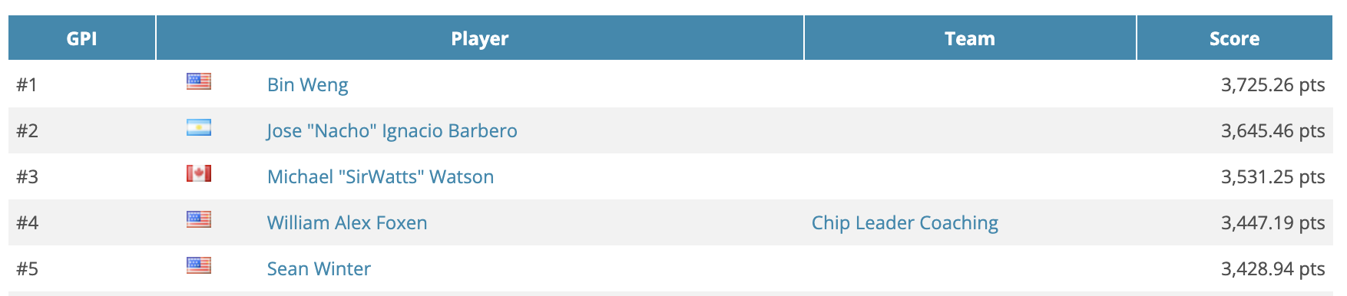
Aggregation in Data Analysis
Why we aggregate:
Summary Statistics: Aggregating data allows us to compute summary statistics such as totals, averages, minimums, maximums, or counts.
Data Reduction: Aggregation condenses large amounts of data into a smaller and more manageable form without losing important insights.
Pattern Identification: Aggregating data helps identify patterns, correlations, or anomalies that may not be apparent at the individual data point level. It allows us to uncover insights and draw meaningful conclusions from the data.
How do I sum, count, mean, min, max and more with Pandas?

Slide 22
Pandas Agenda
Dive into it.
Review
Counting nulls
Understanding Axis
Series Aggregation
Data Frame Aggregation
Group by & Aggregation
Dealing with Multi-Indexes

Slide 23
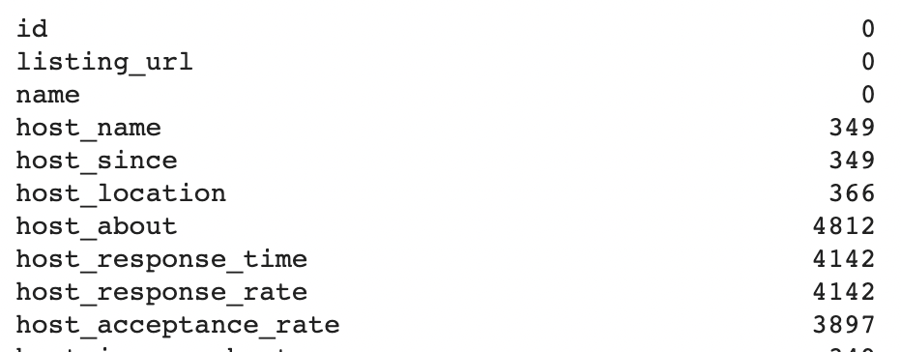
How do I count number of missing values?
df.isnull().sum(axis = 0) or axis = 1
df.isnull().sum(axis = 0)
df.isnull().sum(axis = 1)
df.isnull() – returns a True / False
.sum(axis = 0/1) – sums up the True / False by the Axis
Axis = 0 is for ROWs, i.e. for each column by row (how many nulls in this column)
Axis = 1 is for Columns, i.e. across each row by column (how many nulls in this row)
https://pandas.pydata.org/docs/reference/api/pandas.DataFrame.sum.html

Slide 24
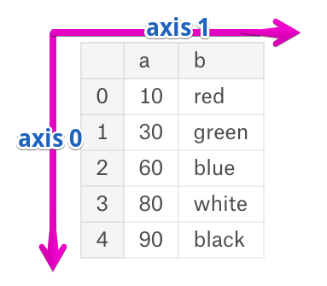
What is an axis?
Rows vs columns
A DataFrame object has two axes: “axis 0” and “axis 1”.
“axis 0” represents rows
“axis 1” represents columns.
Series and DataFrame share the same direction for “axis 0”
Series technically is a single column so no need for axis 1
Why do you care?
Summarizing along the axis – summing across (rows) or down (columns)
Functions operate along axis
Combining appending rows or columns

Slide 25
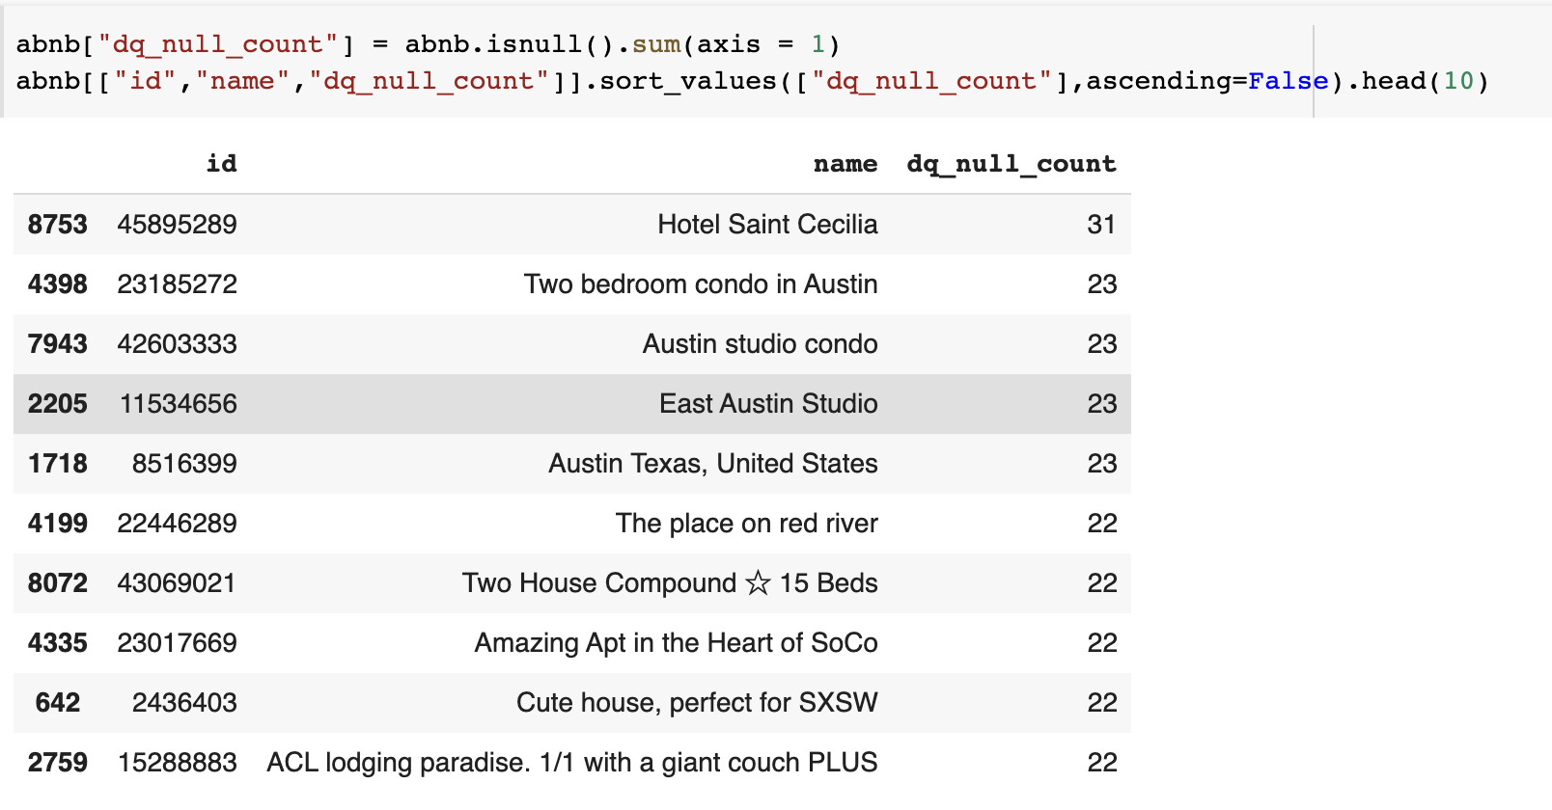
How can I?
Count the nulls by record and add it back to my data frame?
abnb["dq_null_count"] = abnb.isnull().sum(axis = 1)
abnb.sort_values(["dq_null_count"],ascending=False).head(10)
abnb["dq_null_count"].sum()
In this data set there are a total of 60,044 missing values!

Slide 26
Open: 4.1 Null Count Review
10 Minutes

Slide 27
Series
Remember that a A Series
“is a one-dimensional labeled array that is often used to represent a single column of data”
A single column of data from a data frame using a single set of brackets data[column]
Series Aggregation:
Series aggregation allows us to summarize a single column of data.
calculate statistics and perform computations on specific data points.
How can I get the sum, count, mean a single column of data?

Slide 28
Series: Aggregation basics
sum, min, max, median,
Series.sum Return the sum.
Series.min Return the minimum.
Series.max Return the maximum.
Series.median Return the median.
Series.mode Return the mode
Series.count Return number of non-NA/null observations in the Series.
Series.idxmin Return the index of the minimum.
Series.idxmax Return the index of the maximum.
df[“column”].<function>(<options>)
Series
function
Function options

Slide 29
DataFrame
Data Frame Aggregation
Aggregating data is commonly performed on DataFrames ~ data organized in a tabular format. DataFrame aggregation allows us to summarize across multiple columns simultaneously.
How can I get the sum, count, mean a single on DataFrame columns?

Slide 30
Dataframe: Aggregation basics
sum, min, max, median,
df.<function>(<options>)
Data Frame
function
Function options
DataFrame.sum(axis=None, skipna=None, level=None, numeric_only=None, min_count=0
DataFrame.min(axis=None, skipna=None, level=None, numeric_only=None)
DataFrame.max(axis=None, skipna=None, level=None, numeric_only=None)
DataFrame.median(axis=None, skipna=None, level=None, numeric_only=None)
DataFrame.count(axis=0, level=None, numeric_only=False)
DataFrame.nunique(axis=0, dropna=True)
DataFrame.idxmin Return the index of the minimum over the requested axis.
DataFrame.idxmax Return the index of the maximum over the requested axis.

Slide 31
Scientific Notation
Why is everything in scientific notation? And how do I suppress it?
“How can one modify the format for the output from an aggregate operation in pandas that produces scientific notation for numbers?”
There are lazy ways to do this:
Convert from float to string:
Converting numbers to strings purely for aesthetic purposes seems like a bad idea.
df.astype(str)
df = df.round(4)
These are equivalent and generally accepted,
set at top of notebook where you import libraries
pd.options.display.float_format = '{:.4f}'.format
pd.set_option('display.float_format', '{:.2f}'.format)

Slide 32
Open: 4.2 Null Count Review
10 Minutes

Slide 33
Pandas’ .aggregate()
DataFrame.aggregate(func=None, axis=0) or .agg() for short!
df.agg(func=['sum', 'min', 'count', 'nunique', 'mean’], axis=0)
Data Frame
List of functions
Axis to apply to
Standard functions
Sum, min, max, count, nunique
Mean, median, mode etc.
https://pandas.pydata.org/pandas-docs/stable/reference/api/pandas.DataFrame.aggregate.html

Slide 34
Open: 4.3 Pandas Aggregate
10 Minutes

Slide 35
How about a little more complex…
.aggregate() function provides a flexible way to apply aggregations to our data.
Apply lots of aggregations to columns or specific aggregations by column
.aggregate() :
.aggregate() in pandas allows us to apply one or more aggregation functions to our data.
It takes a dictionary of column names as keys and aggregation functions as values.
functions include sum(), mean(), max(), or custom functions.
groupby().aggregate():
The groupby() function is used to split the data into groups based on specified criteria.
By combining groupby() with .aggregate(), we can perform aggregations on each group separately.
This enables us to analyze and compare subsets of data based on specific groupings.

Slide 36
But how can I specify specific columns
Or just numeric or object data types?
# -- select columns --
abnb[["bedrooms", "number_of_reviews"]].aggregate(func=['mean', 'min', 'max'])
# -- specify dictionary w. list of functions to apply
abnb.aggregate({"bedrooms": ['mean', 'min', 'max'],
"number_of_reviews": ['mean', 'min', 'max', 'median']})
# -- select all numeric columns --
abnb.select_dtypes(include='number’) \
.aggregate( func = ['sum', 'min', 'count', 'nunique', 'mean'])

Slide 37
So how can I group by a category?
Group by, split , apply and combine.
“group by” refers to the process of :
Splitting the data into groups based on some criteria.
Applying a function, like aggregate, to each group independently.
Combining the results back into a data frame.
# -- apply same aggregates to each column
df.groupby(‘column_A’)[[“column_B”, “column_C”]].agg(['min', 'max'])
Group by a column name
Columns to aggregate
Aggregate functions
# -- apply different aggregates to specified column
df.groupby('column_A').agg({'column_B': ['min', 'max'], 'column_C': 'sum'})
Columns and aggregates to apply

Slide 38
Introduction to GroupBy
Group your data.
.groupby([column1,column2]) function is used to group data based on one or more columns.
Enables operations on groups of data, such as aggregation, transformation, or filtering.
Syntax:
grouped = dataframe.groupby('column_name')
Here, 'column_name' represents the column(s) we want to group the data by.
Common Aggregation Functions:
sum(): Calculates the sum of the values in each group.
mean(): Computes the mean (average) of the values in each group.
count(): Counts the number of records in each group.
min(), max(): Returns the minimum and maximum values in each group.
size(): Returns the size (number of elements) of each group.
agg(): Allows us to apply custom aggregation functions or perform multiple aggregations simultaneously.

Slide 39
Can I group by more than one column?
Yes you can – pass a list of columns [‘column1, column2’]
When we group by in pandas – it sorts the data before splitting
# -- apply same aggregates to each column
df.groupby([‘column_A’, column_D’])[[“column_B”, “column_C”]].agg(['min', 'max'])
Same aggregate applied to selected columns
Group by multiple columns
# -- apply different aggregates to specified column
df.groupby(['column_A’, ‘column_D’]).agg({'column_B': ['min', 'max’], \ 'column_C': 'sum'})
Group by multiple columns
Different aggregates applied to selected columns

Slide 40
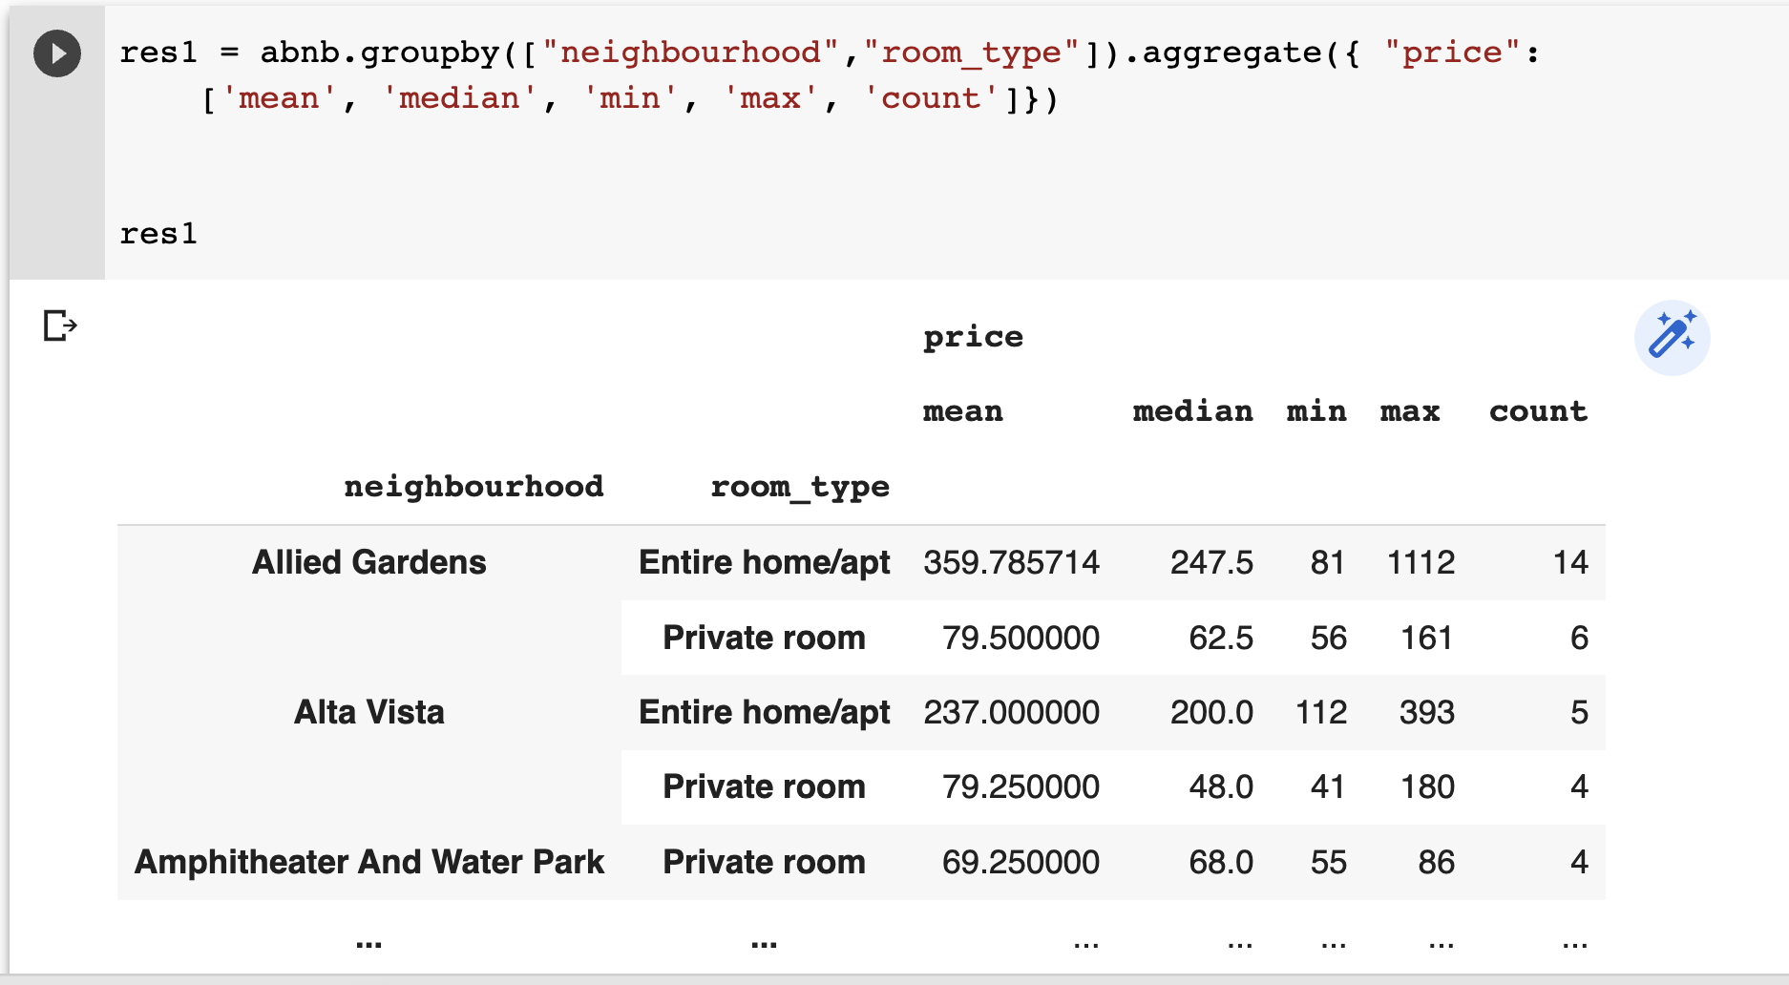
Produces a weird result!
Multi-level-index
COLUMN INDEX
ROW INDEX
What do you do?
Reference the columns in multi-index
OR
.stack() flattens / reshapes the data frame’s index

Slide 41
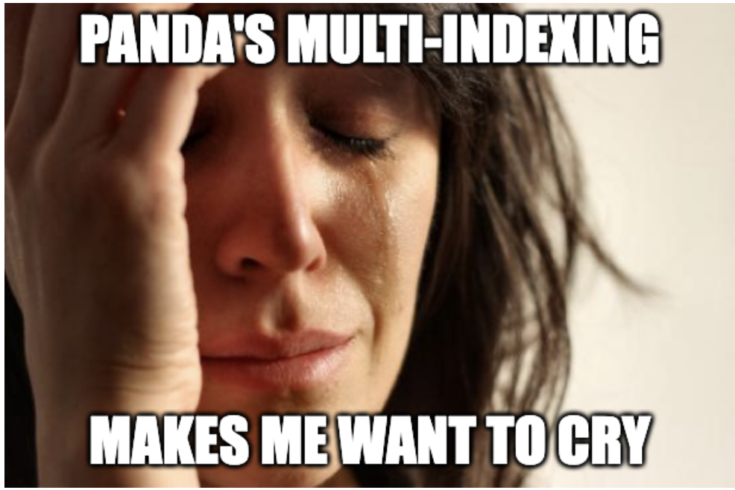
Here is what panda’s says
About multi-level indexing
Multi-level indexing, also known as hierarchical indexing, is a powerful feature in pandas that allows for the representation of higher-dimensional data in a tabular format. It provides a way to work with data that has multiple levels of row and column labels, enabling more complex data organization and analysis. Here's a summary of multi-level indexing in and manipulation of multi-dimensional data, providing a versatile framework for data exploration and analysis.
But it’s BS
They are darn hard to work with

Slide 42
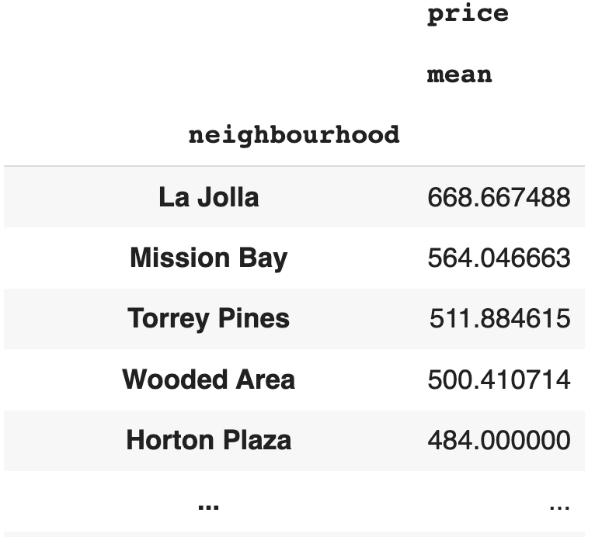
Panda’s Multi-Level-Indexes
Referencing (level1,level2,…)
res1 = abnb.groupby("neighbourhood").aggregate({ "price":
['mean', 'median', 'min', 'max', 'count']}).sort_values(("price","mean"), ascending=False) print(res1.columns) res1[('price','mean')]
MultiIndex([('price', 'mean’),
('price', 'median’),
('price', 'min’),
('price', 'max’),
('price', 'count')], )
Single bracket + (level1,level2) returns a series
Bracket bracket + (level1,level2) returns a data frame
# Series
neighborhood
La Jolla 668.667488
Mission Bay 564.046663
Torrey Pines 511.884615
Wooded Area 500.410714
Horton Plaza 484.000000 ...
DataFrame

Slide 43
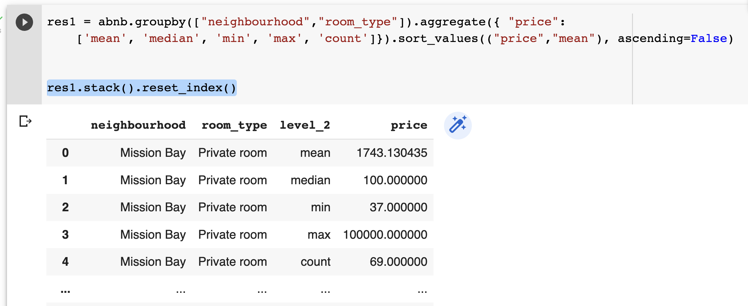
Flattening the Multi-index
.stack().reset_index()
res1.stack().reset_index()
res1.stack().reset_index()
Stack reshapes the data frame
Reset Index flattens

Slide 44
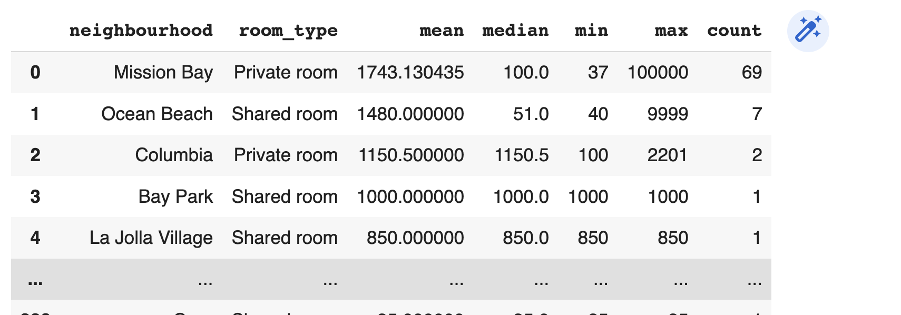
OR simply
Rename the columns
# reset the index
res1 = res1.reset_index()
# rename the columns
res1.columns = ["neighbourhood","room_type","mean",
"median","min","max","count"]
# present
res1

Slide 45
Open: 4.4 Pandas GroupBy
10 Minutes

Slide 46

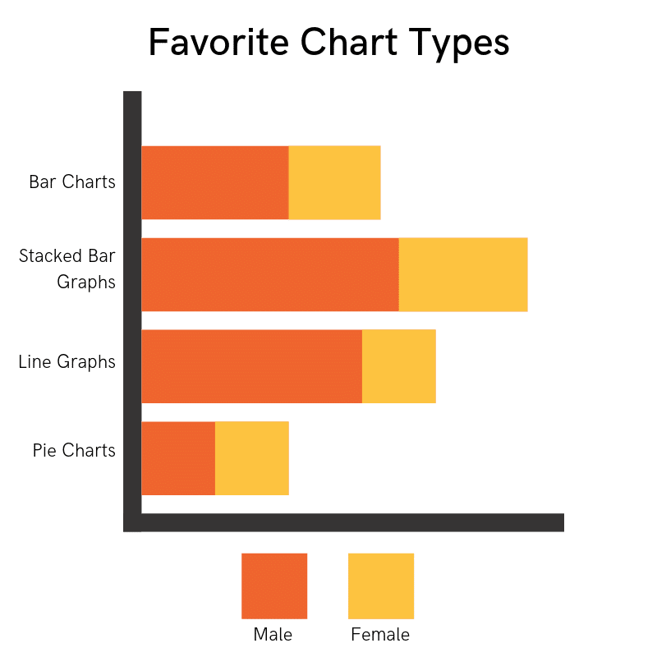
Intro to Visualization
Data visualization is an essential skill for any business analyst or data scientist – "A picture is worth a thousand words" .
Pandas and Matplotlib
Basic Recipe for Visualization
"Visualization gives you answers to questions you didn't know you had." - Ben Schneiderman

Slide 47
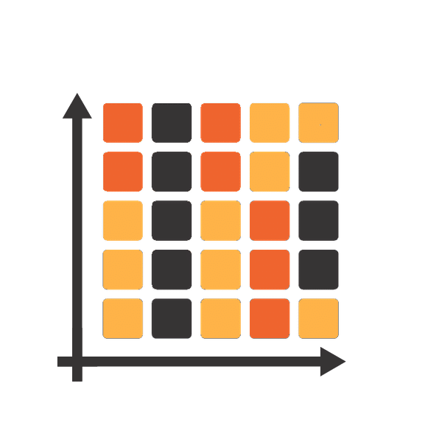
Matplotlib
Pyplot sub module
Relationships
scatter
Distributions
hist
Categorical
bar
boxplot
pie
boxplot
plot
You must do this in your notebooks!
import matplotlib.pyplot as plt
%matplotlib inline

Slide 48
Distribution visualization
Only works with - Numeric Data
Both boxplots and histograms provide a visual representation of the distribution of data, but they differ in their level of detail and the specific aspects of the distribution that they emphasize.
Boxplots display the distribution of a continuous numerical variable by showing its quartiles (minimum, first quartile, median, third quartile, and maximum)
Histograms represents the distribution of a continuous numerical variable by dividing it into equal intervals(bins) and showing the frequency(count) of data points in each interval as bars.

Slide 49
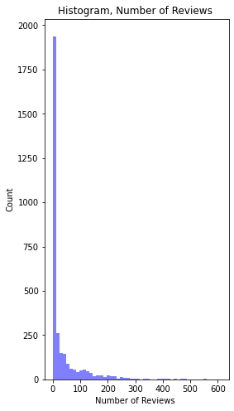
Plotting basics = .hist()
Histogram = distribution of numeric data
Histograms only work on numeric data
Data is split into equal-width bins
More bins = more granularity
Frequency ”count” by bin
import matplotlib.pyplot as plt
plt.figure(figsize=(4,8))
plt.hist(abnb['number_of_reviews’],
bins=50, # control granularity
facecolor='blue’,
alpha=0.5)
plt.title('Histogram, Number of Reviews ')
plt.ylabel('Count')
plt.xlabel('Number of Reviews ')
plt.show()

Slide 50
Histograms w. Matplot lib
Plt.hist(variable, bins, facecolor, alpha)
import matplotlib.pyplot as plt
plt.figure(figsize=(4,8))
plt.hist(abnb['number_of_reviews’],
bins=50,
facecolor='blue’,
alpha=0.5)
plt.title('Histogram, Number of Reviews ‘)
plt.ylabel('Count’)
plt.xlabel('Number of Reviews ‘)
plt.show()
Import matplotlib’s pyplot submodule
Controls the figure size length by height
Histograms require
Numeric data
Number of bins
Options
3. Color & 4. transparency
Title
Y-Axis Label
X-Axis Label
Display your plot

Slide 51
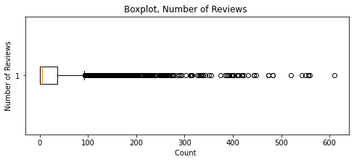
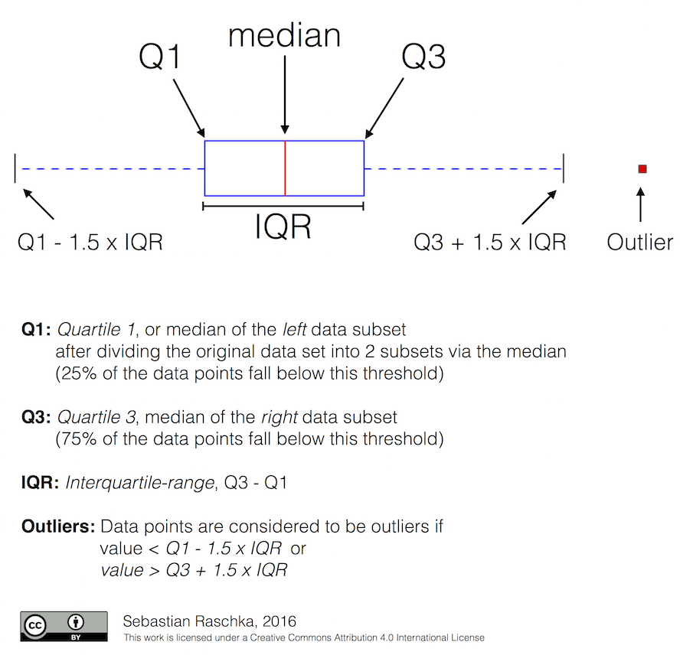
Boxplot
Distribution of data
# -- figsize= (Width, Height) --
plt.figure(figsize=(8,5))
# -- simple boxplot of number variable
plt.boxplot(abnb['number_of_reviews’], vert=False)
plt.title ('Boxplot, Number of Reviews ')
plt.ylabel('Number of Reviews')
plt.xlabel('Count ')
plt.show()

Slide 52
Bar Chart = Two Step
First: group by and aggregate your data into a Result
Then: Plot the Result
Eyeball your Result
plt.bar(x, height, width=0.8, bottom=None,)

Slide 53
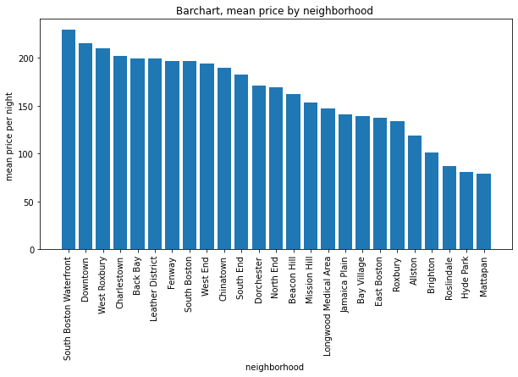
Bar Chart = Two Step
plt.bar(x, height, width=0.8, bottom=None,)
# -- first summarize, create a result set --
res1 = (abnb.groupby('neighbourhood')[['price']].agg('mean’)
.reset_index() # -- turn group by index into a variable
.rename(columns={'price':'mean price’}) # -- rename column to something useful.
.sort_values(['mean price'], ascending = False) # -- sort the bars
)
res1.head()
# -- then plot --
plt.figure(figsize=(10,5))
# -- bar plot --
plt.bar(res1['neighbourhood'], res1['mean price'])
plt.title('Barchart, mean price by neighborhood ')
plt.ylabel('mean price per night ')
plt.xlabel('neighborhood ')
plt.xticks(rotation=90)
plt.show()

Slide 54
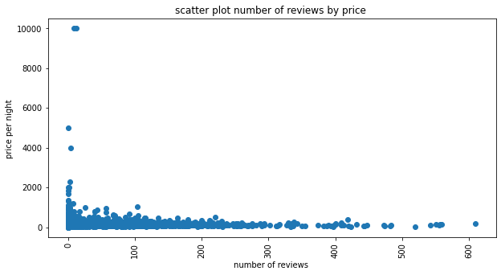
Scatter Plot
plt.scatter(x, y, s=None, c=None, marker=None, cmap=None)
# -- then plot --
plt.figure(figsize=(10,5))
# -- scatter plot --
plt.scatter(abnb['number_of_reviews'], abnb['price'])
plt.title('scatter plot number of reviews by price ')
plt.ylabel('price per night ')
plt.xlabel('number of reviews ')
plt.xticks(rotation=90)
plt.show()
A ScatterPlot displays the relationship between two continuous numerical variables. In a scatterplot, each data point is represented as a dot on a two-dimensional plane.

Slide 55
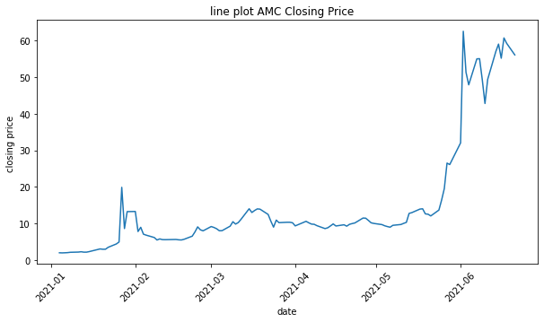
Line Plot
A line plot is used to visualize time series data, a series of data points collected at regular intervals over a specified period of time. The line plot is useful in showing the trend and patterns of the time series data over time, allowing us to identify trends, seasonality, and any other anomalies in the data.
plt.plot(x,y)
plt.figure(figsize=(10,5))
# -- scatter plot --
plt.plot(AMC['Date'], AMC['Close'])
plt.title('line plot AMC Closing Price ')
plt.ylabel('closing price ')
plt.xlabel('date')
plt.xticks(rotation=45)
plt.show()

Slide 56
Open: 4.5 MatplotLib
20 Minutes

Slide 57
Open: 4.6 Practice
20 Minutes

Slide 58


